Slide 1
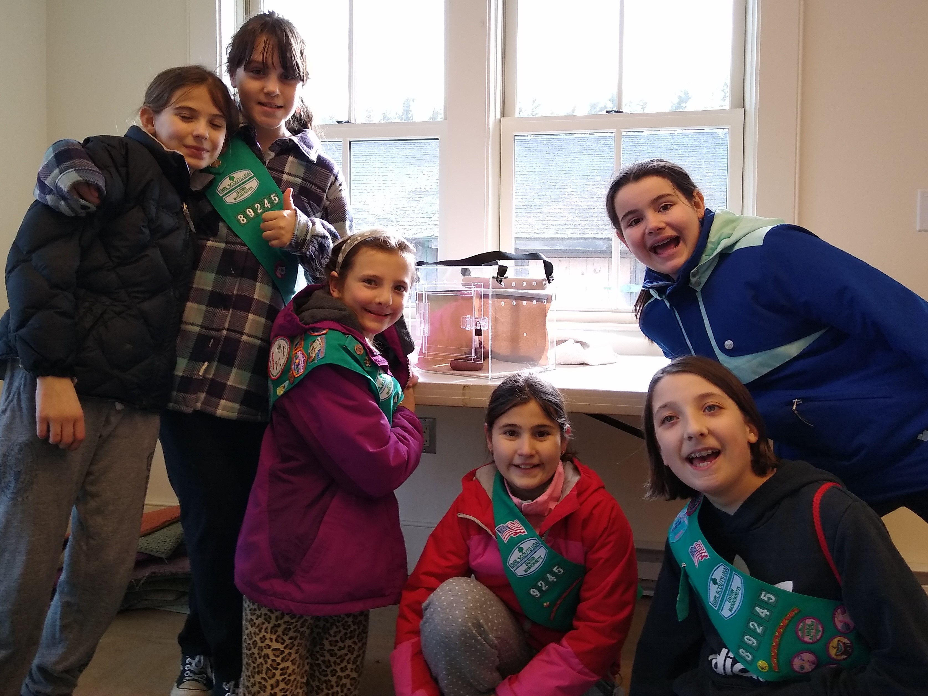
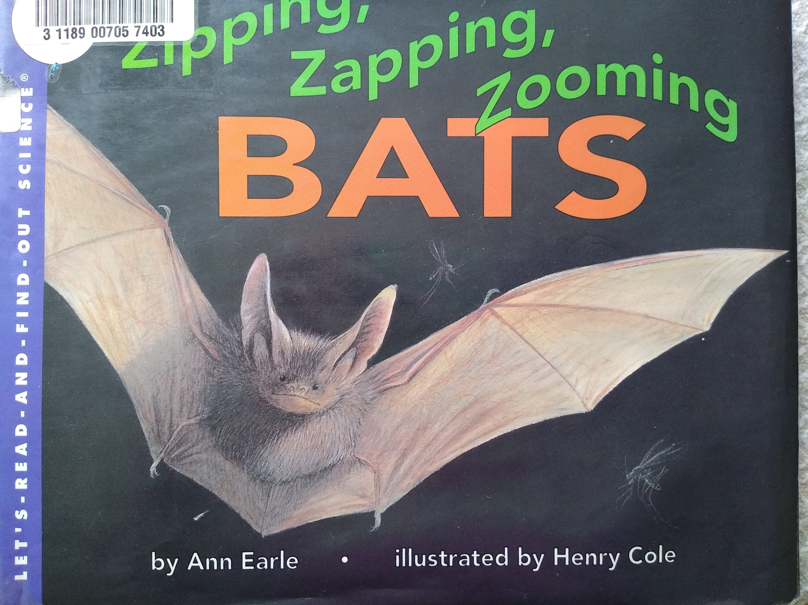
Bats Are Our Friends!
By: Girl Scout Troop 89245
Troop 89245 at Drumlin Farm learning about bats in February, 2020 before the onset of the corona virus pandemic.
Our book is based on Zipping, Zapping, Zooming Bats by Ann Earle. We learned about putting paragraphs into our own words. Any text close to the original is unintentional!

Slide 2
Acknowledgements:
This book could not have been created without the amazing residents of Sudbury and beyond that bought bat boxes from us, the person who sold us the pre-cut pieces of wood, and the amazing places that have agreed to put up boxes.
We would like to thank Camp Sewataro for agreeing to hang our bat boxes around their camp.
We also would like to thank the wonderful Sudbury residents that have bought our boxes and hung them by their houses.
We also would like to thank Joe who made us kits to build the bat boxes. We found him on Etsy and he was incredibly kind to bend his own rules to make us the kits for our boxes.
With all thanks, Bronze Patrol 89245

Slide 3
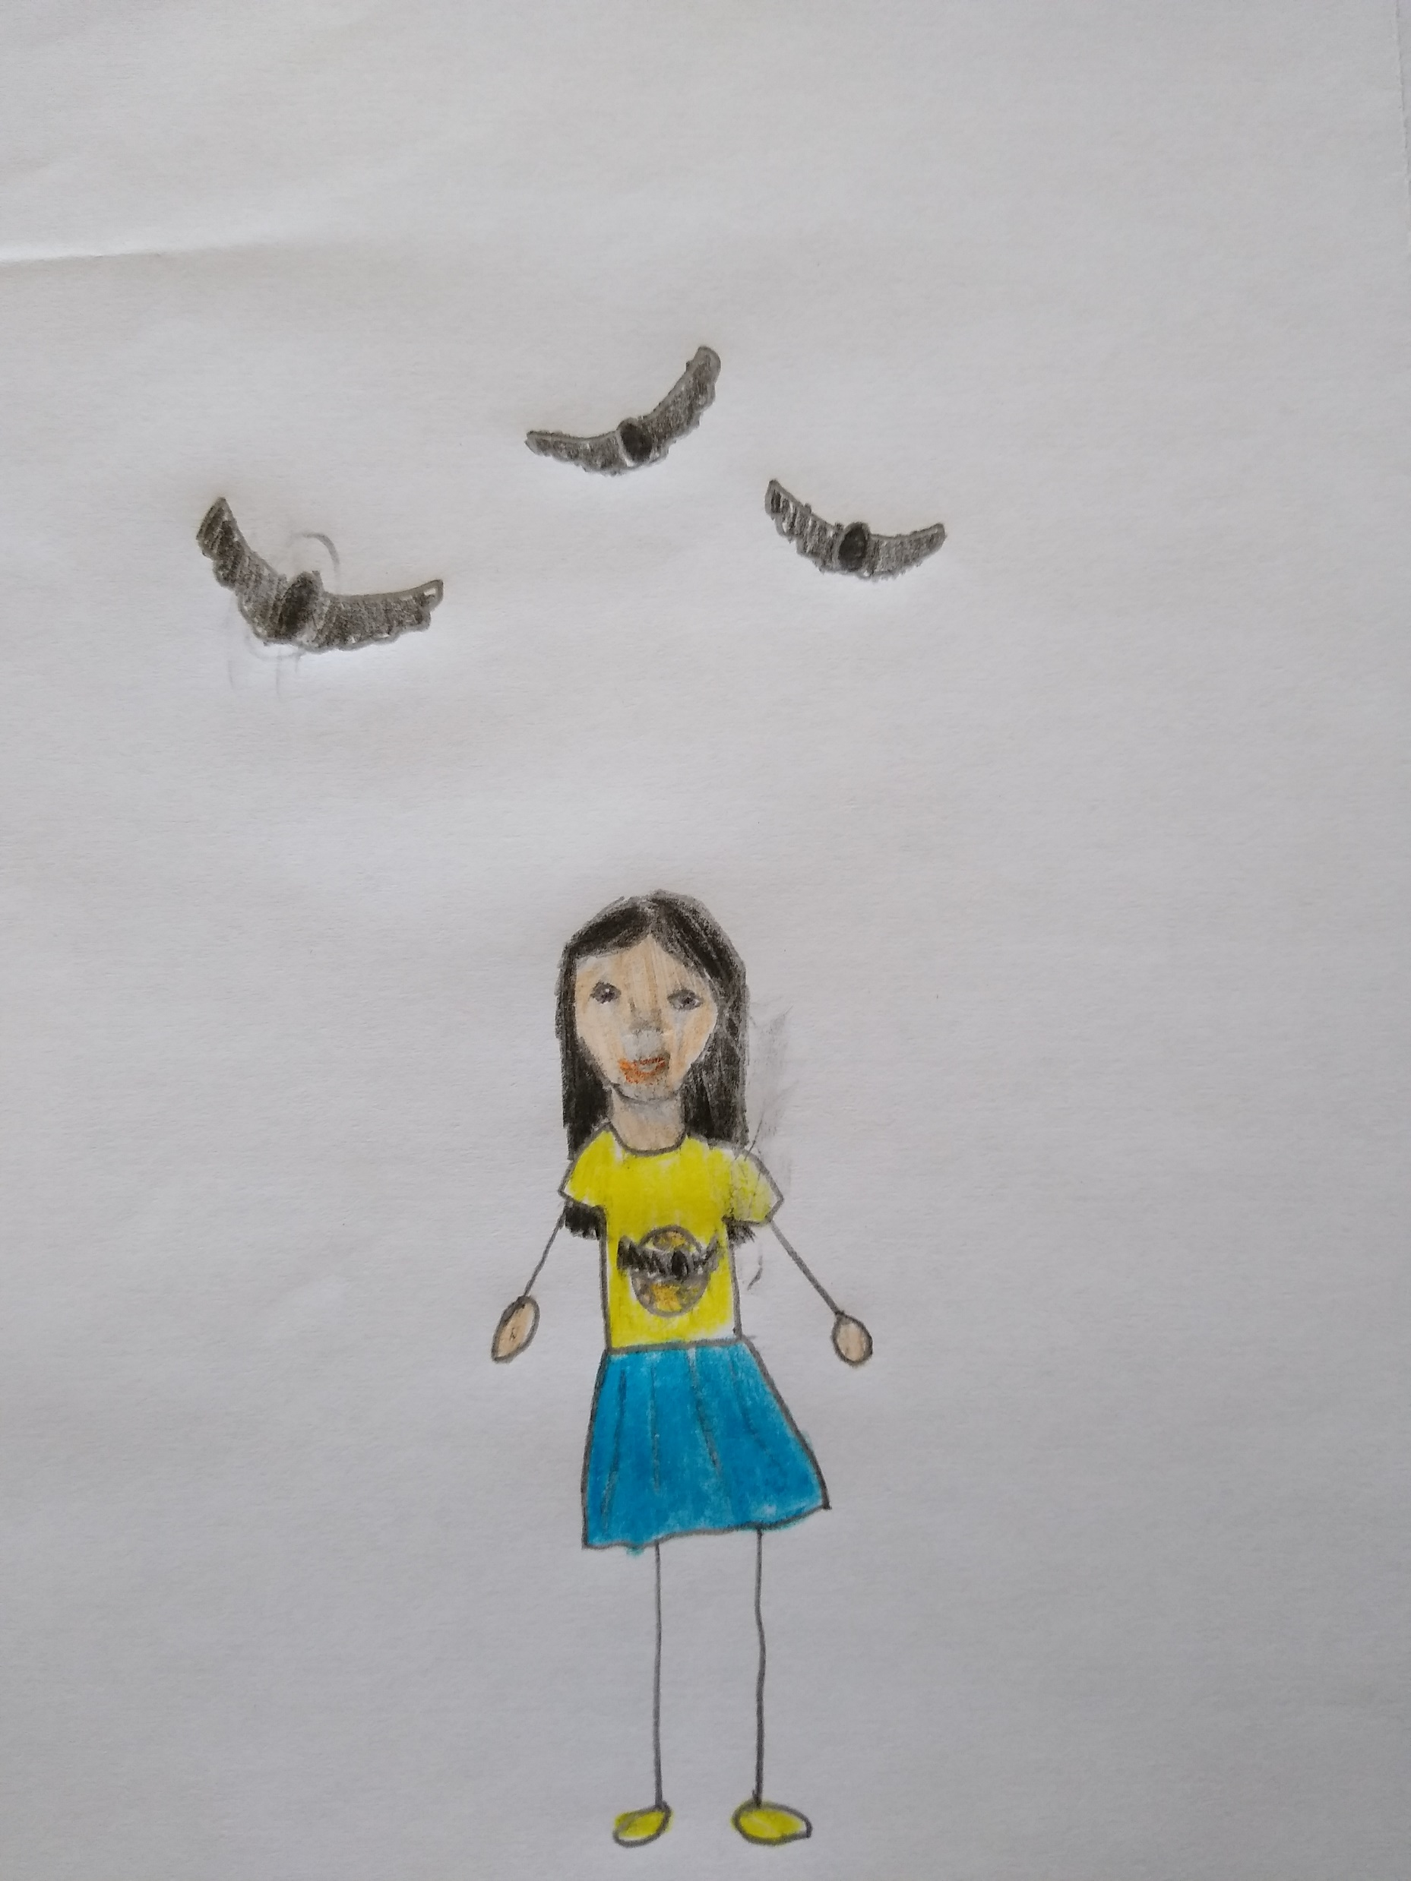

Some people are afraid of bats because they fly at night in the dark. But you shouldn’t be afraid because bats are really very nice and only fly at night because that’s when they need to get their food. Sometimes you might hear stories about bats that turn into vampires – but these are not real!

Slide 4
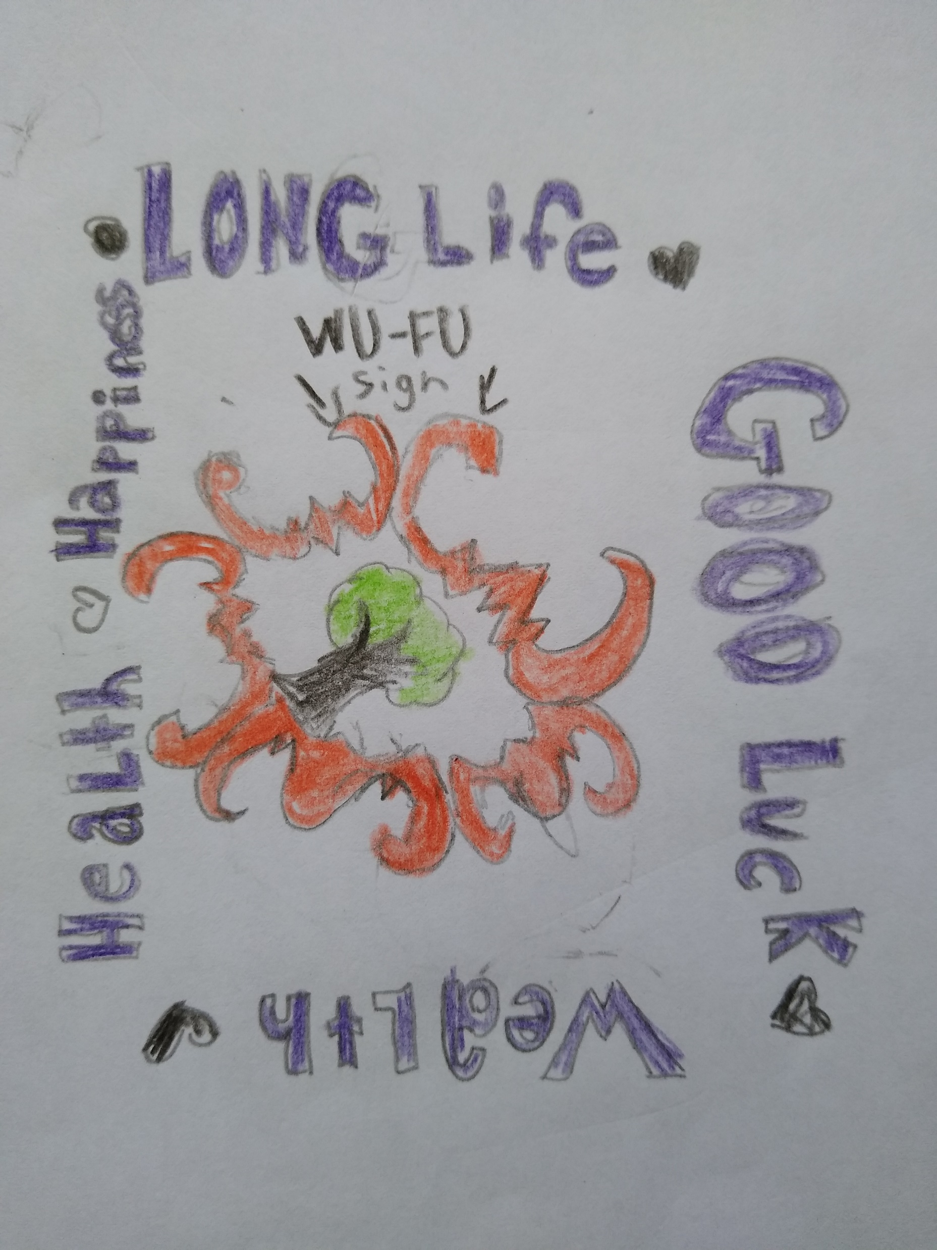
In China, bats are good luck! There is something called a wu-fu sign, on which there are 5 bats in a circle with their wings touching and a Tree of Life in the middle of the circle. It’s kind of like a four-leaf clover. The five bats of the wu-fu sign represent: long life, good luck, wealth, health, and happiness.

Slide 5
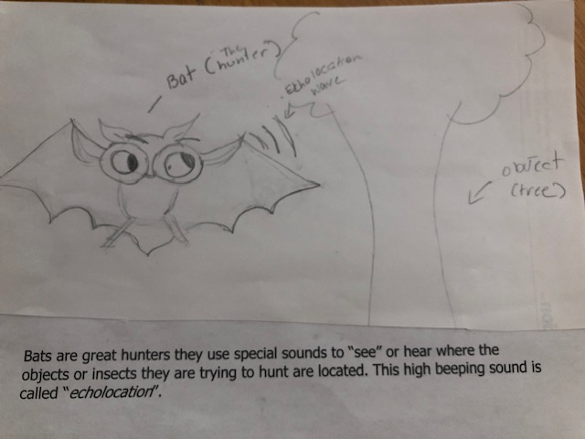


Slide 6
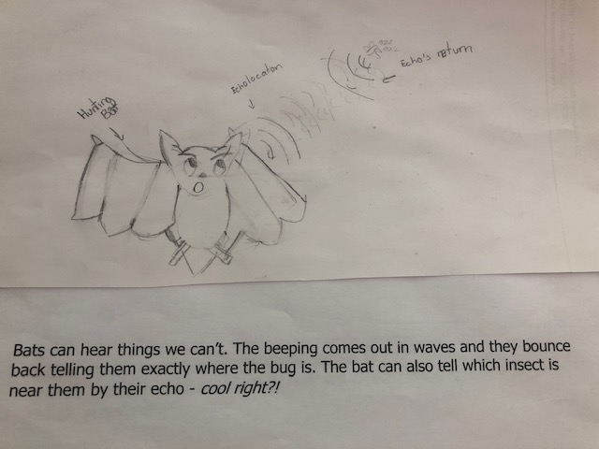

Slide 7
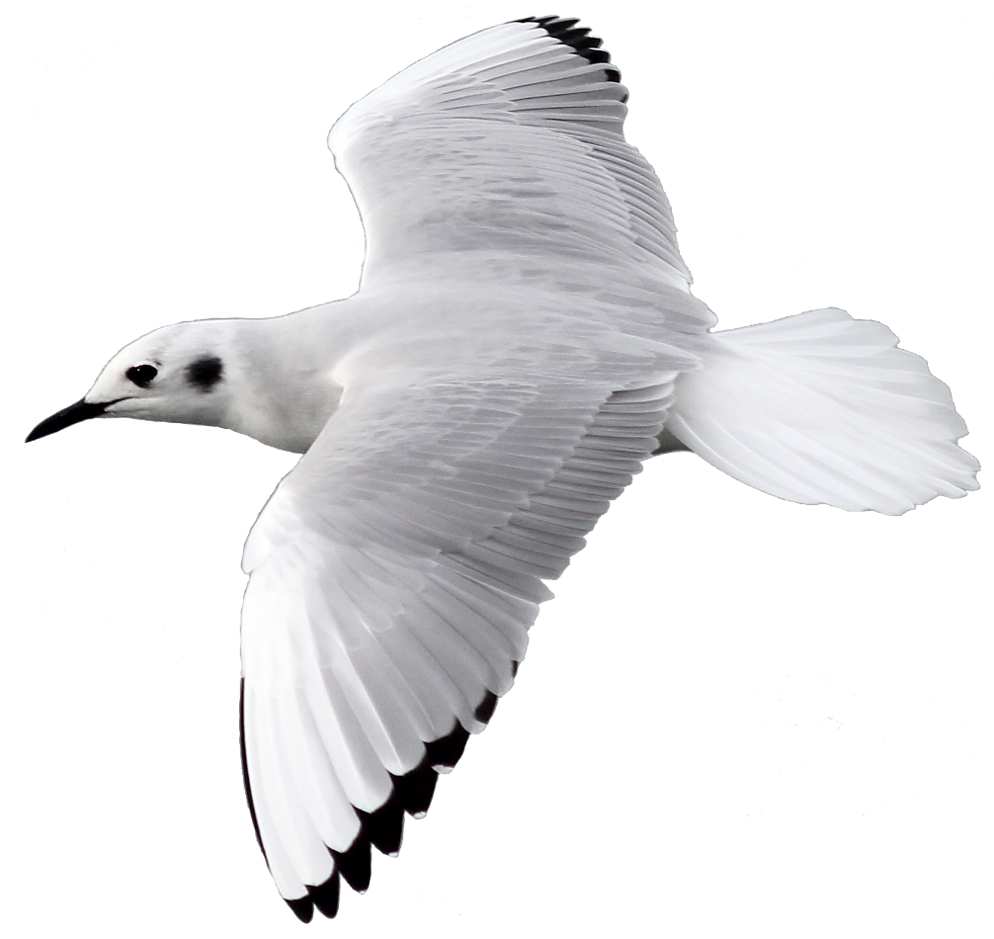
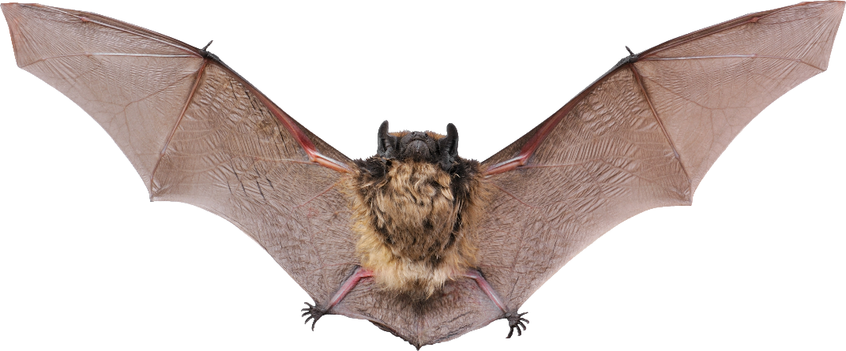
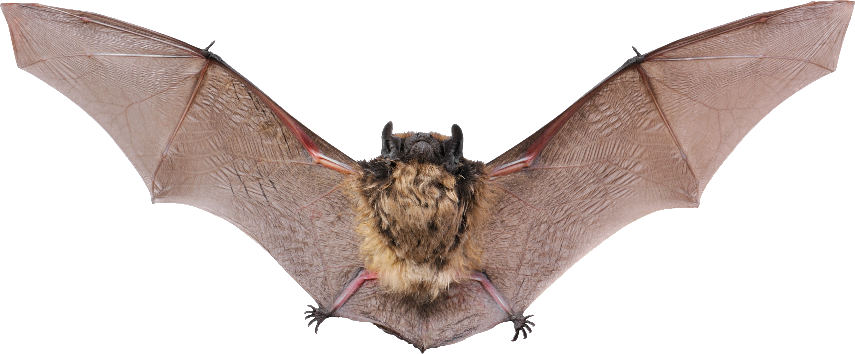
Bats are also good hunters because they are very good at flying. Their wings are different from bird wings. Bats wings have long arm bones with extra long finger bones. A thin skin called a membrane stretches between the bones. The membrane connects the wing bones to the bat’s legs and body. It may also join the tail to the legs.

Slide 8
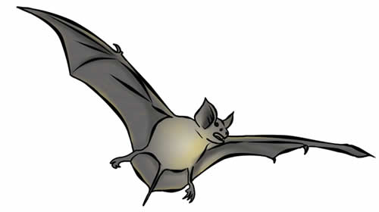
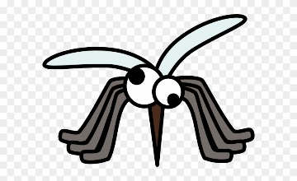
Bat wings are like webbed hands. A flying bat can move its wings much the way you can move your fingers. This means a bat can quickly change the shape of its wings. If a bug dodges away, that bat can zigzag fast and chase it. A bat can catch a flying insect in its wing, flip it into its tail membrane, and then scoop it into its mouth.

Slide 9
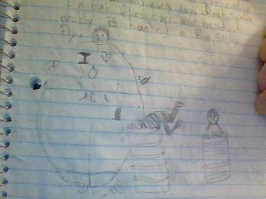
Lots of bats love to eat bugs. They eat a bunch of bugs. A
2-pound bat will eat 1 pound of bugs. If you were 600 pounds that's like eating 1250 lemons every day. Don't scream if a bat flies over your head it's probably just hunting a big juicy fly.

Slide 10
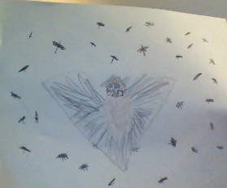
Bats are magnificent hunters. A little brown bat can eat 150 bugs in 15 minutes. A gray bat can munch 3000 bugs in one night. Bats also kill moths, grasshoppers, and beetles. These insects eat crops that you and I need. Bracken cave in Texas is home to 20 million bats. Together they gobble 250 tons of insects each night.

Slide 11
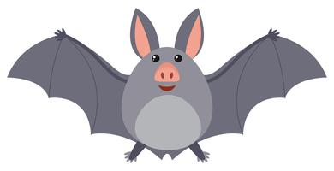
Bats have hooked claws on their toes and thumbs. When bats clean themselves, they hang upside down by their toe claws. They use their claws to move around in their roosts, to comb their fur and clean their ears. Bats keep themselves as clean as cats, using both their tongues and claws.
Finger Claws
Toe Claws

Slide 12
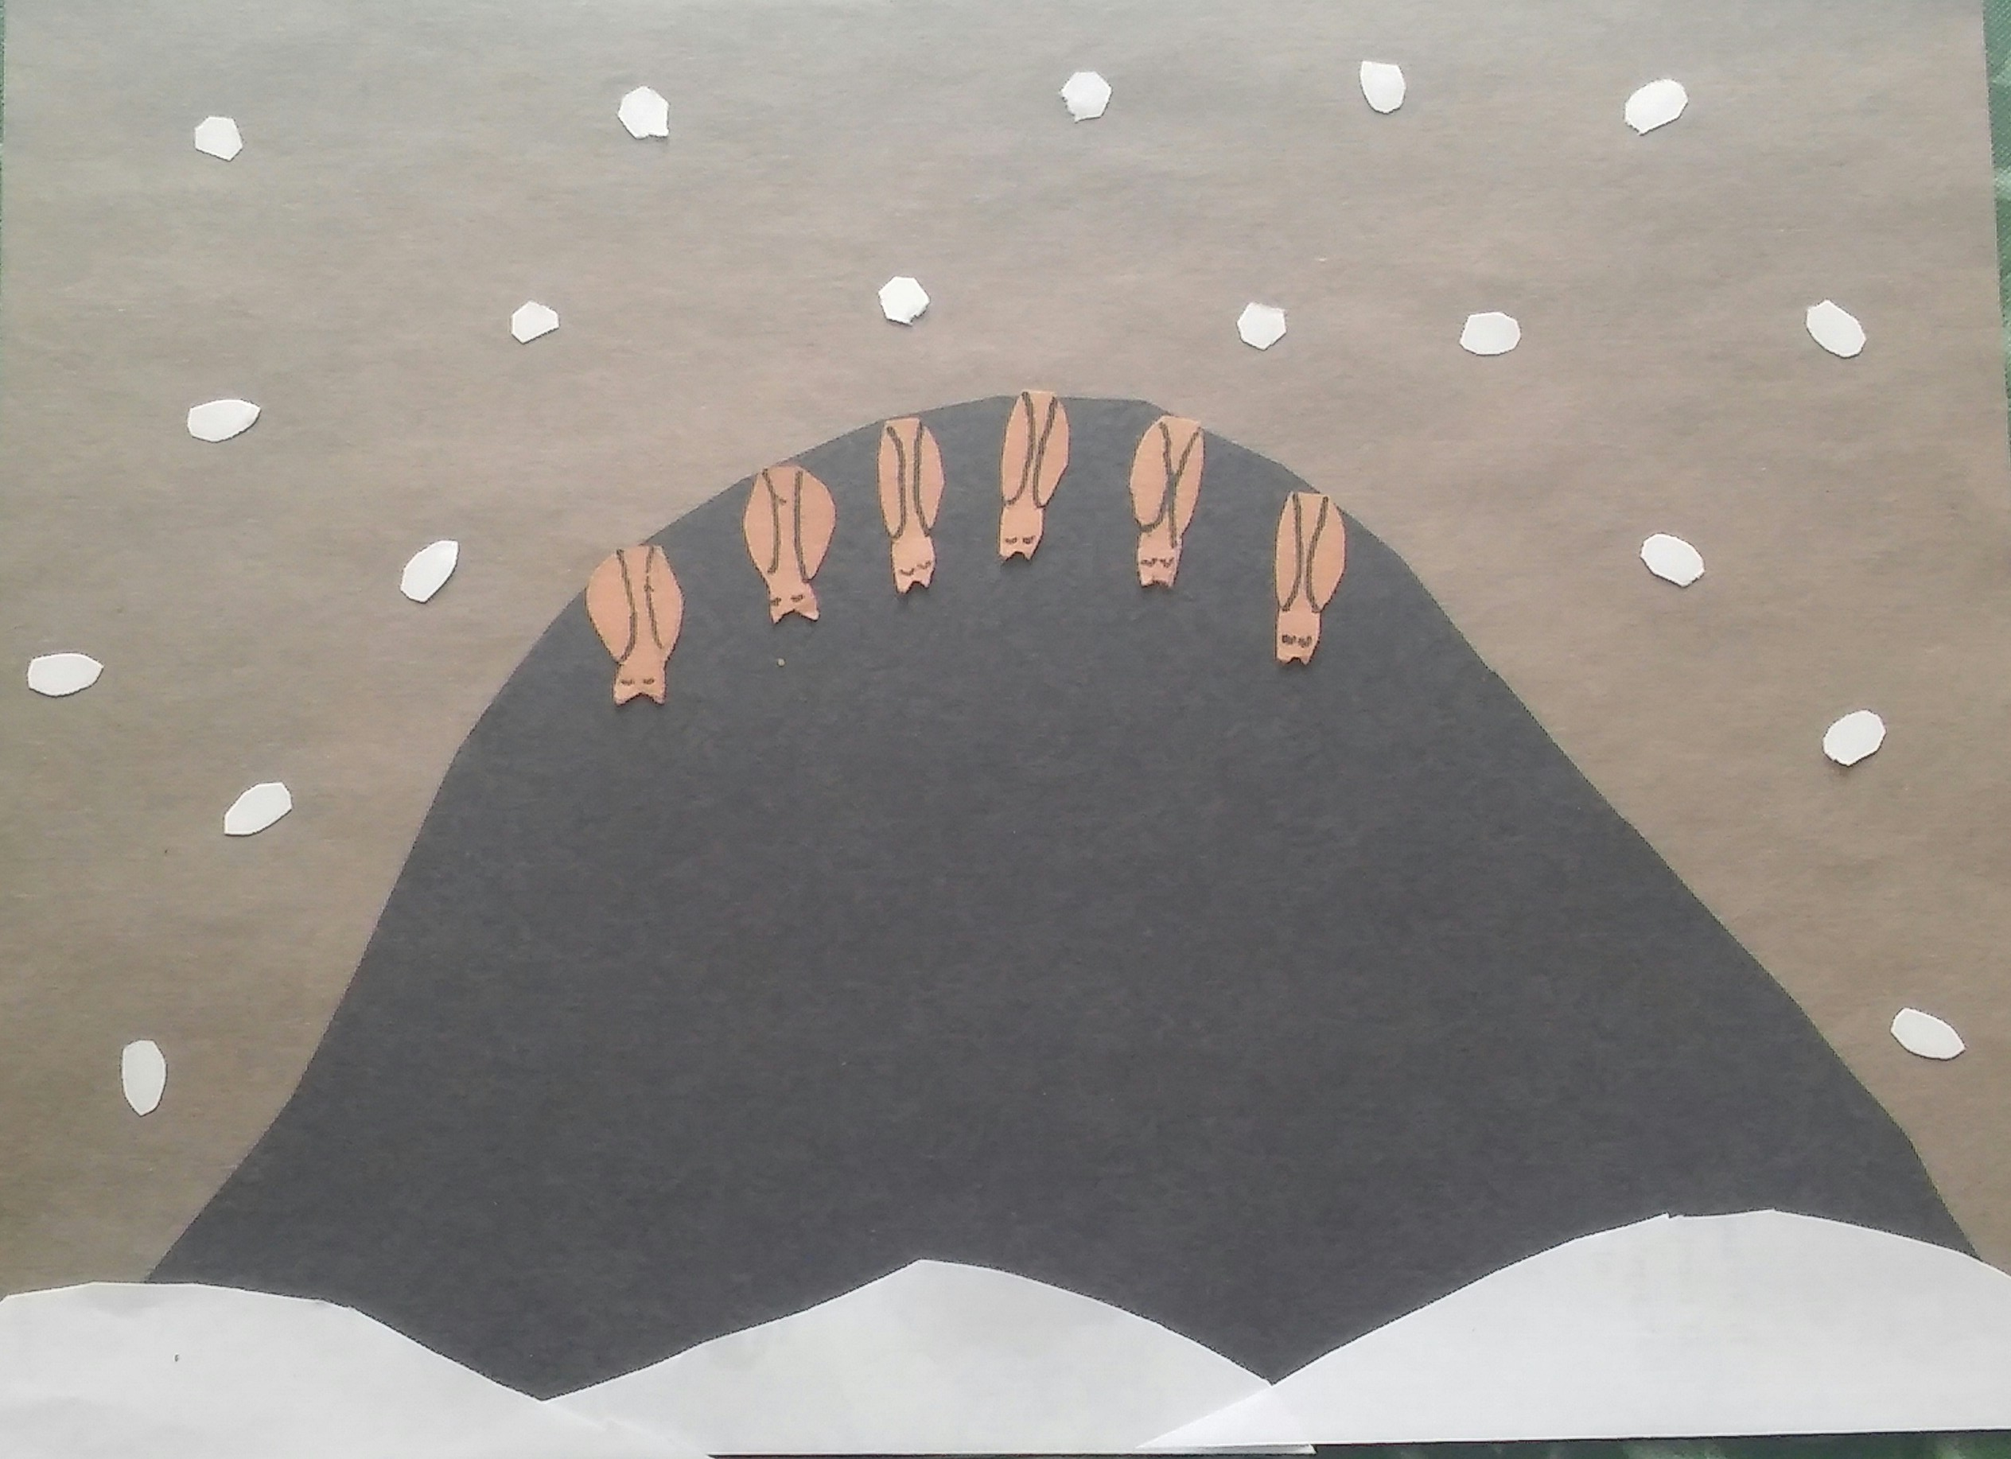
Just like bears, bats hibernate in the winter, and just like bears, they eat a lot of food before they go to sleep.The extra food they eat is stored as fat, which will feed the bat during the winter. The bats don’t need as much food when they are hibernating, because their heart rate drops from 900 beats a minute to only 20 beats per minute. If you go into a cave in the winter, you would wake up the bats if they are hibernating there. If they woke up, they would use a lot of their stored food, about a month’s worth of it, which could cause them to starve before they can get more food.

Slide 13
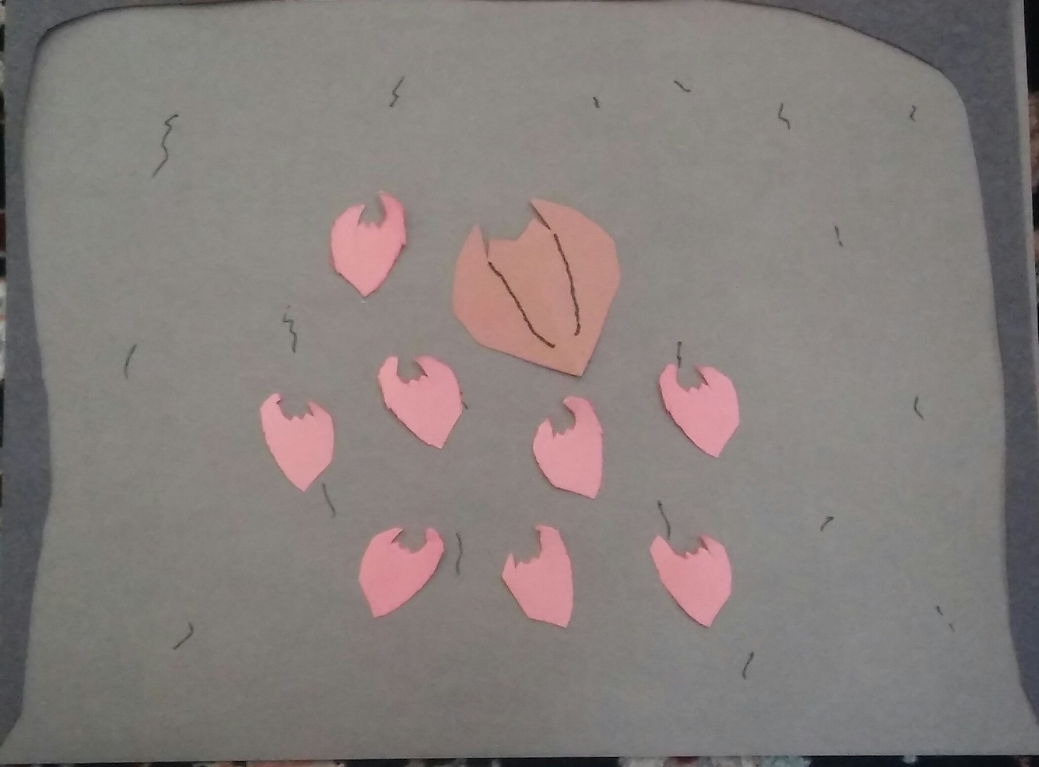
You might know that humans are mammals, which means that the babies don’t hatch from eggs, and they get milk from their mothers. But did you know that bats are also mammals? They are the only mammals that fly. In June and July, you might see groups of baby bats or pups, called nurseries, in a cave. A mother bat will come to feed the pups 2 times every day. If you find pups in a cave, you should quietly leave, so that you don’t bother them. If you don’t, you could scare the mother bat away from the pups, and they won’t get their food, and could die.

Slide 14
People destroy bats’ homes in many ways. They rip apart old barns and seal off empty mines where bats live. They also close off attics. The worst of all, that is not only bad for bats, it’s deforestation!!☹ And because of all that, they may go extinct​.

Slide 15
Luckily for us, there are many ways for us and everyone to help! You can put a bat house on your lawn!😃
Some groups are putting gates on entrances to caves so bats can get through and humans can’t. There are some clubs that people can join to help bats.

Slide 16
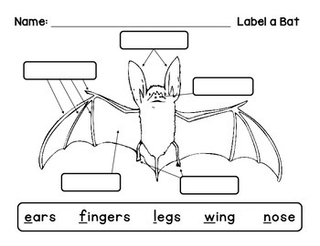
Body Parts of a Bat
Ears
Fingers and Finger Claws
Nose
Wing membrane
Toes and Toe Claws

Slide 17

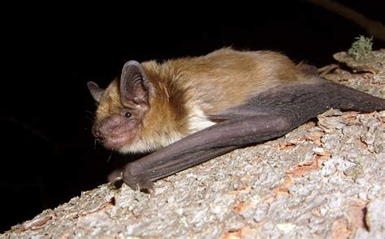
We hope you enjoyed reading our book about bats! Please help us know how many people have seen our work by filling out this short survey – no personal information is requested! Thank you.
Brown Bat - Massachusetts

